Slide 1

HOUSE PRICING ANALYSIS AND PREDICTION
BY
DAVIS KIPROP 21-2147

Slide 2
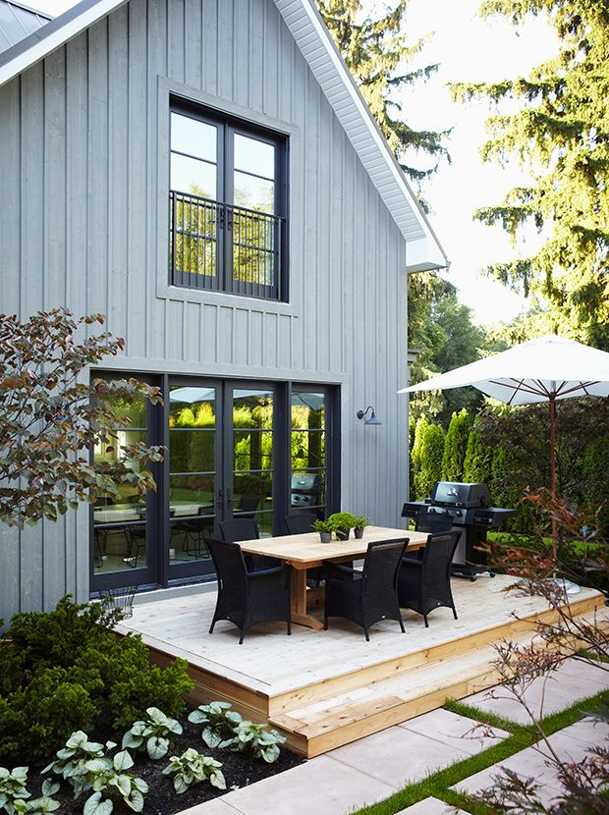
INTRODUCTION
The purpose of this project is to analyze a dataset containing information on houses sold and use that analysis to create a machine learning model that can predict the sale price of a house.
The dataset contains information on houses sold in a particular area, including the size of the house, the number of bedrooms and bathrooms, the location, and the sale price.
I used Python and various libraries such as Pandas, Matplotlib, and Scikit-learn to analyze and visualize the data. My approach was to clean and preprocess the data, conduct descriptive and inferential analysis, and then build machine learning models to make predictions.

Slide 3
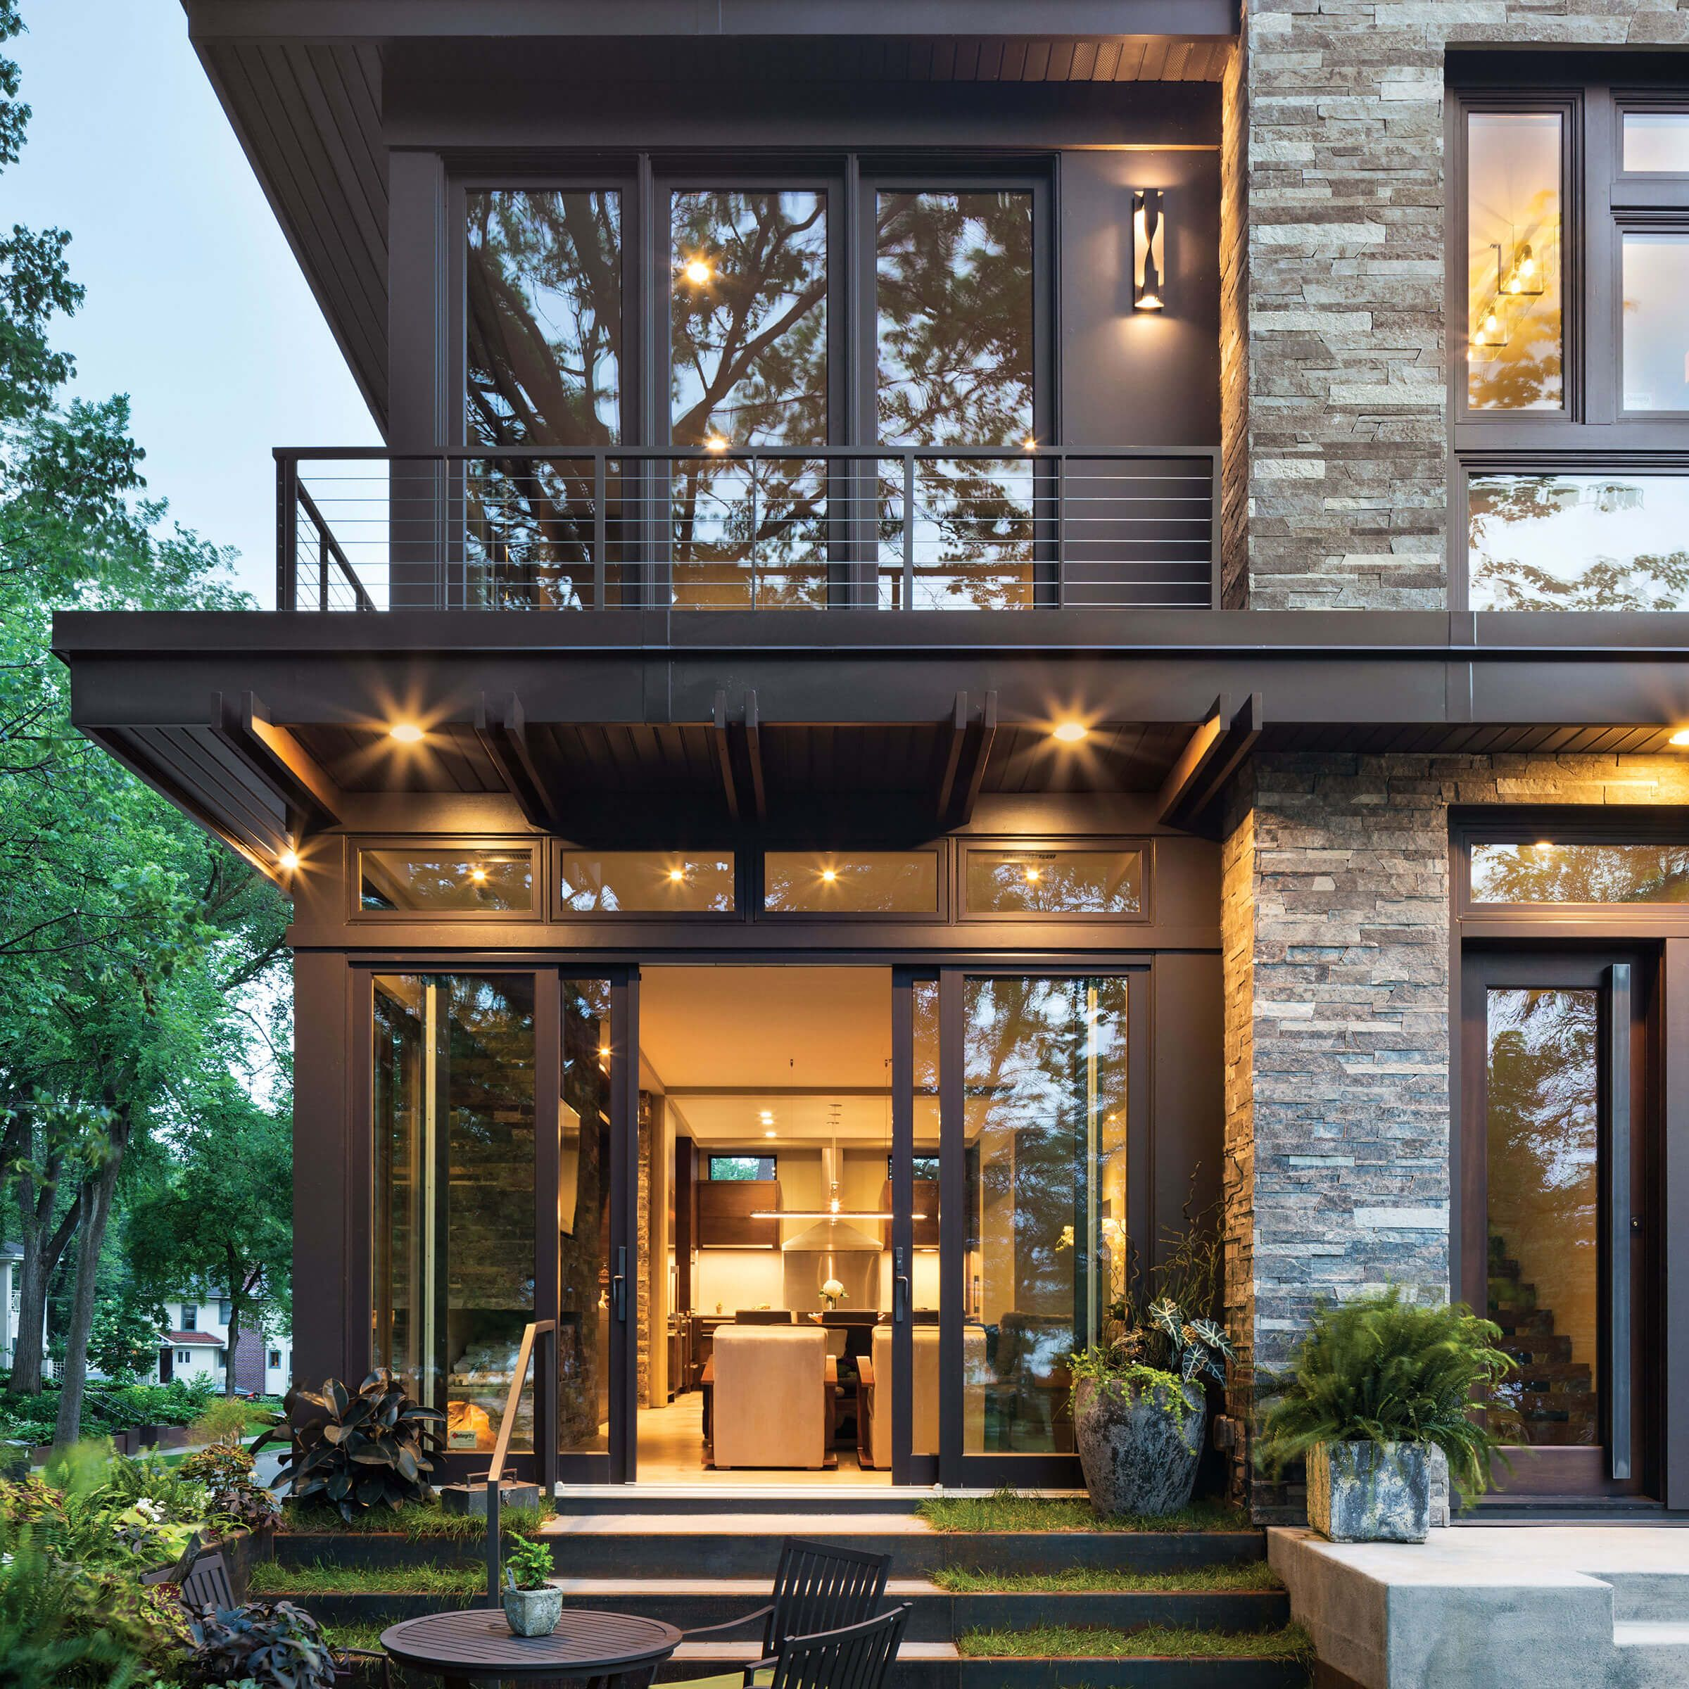
Descriptive Analysis
I calculated descriptive statistics for the sale price, the size of the house, the number of bedrooms and bathrooms, and other key variables. I also created histograms and box plots to visualize the distribution of the data.
I created scatter plots and correlation matrices to visualize the relationship between the sale price and other variables such as the size of the house and the number of bedrooms.
I used various graphs, charts, and tables to convey our findings, including histograms, box plots, scatter plots, correlation matrices, and heatmaps.

Slide 4
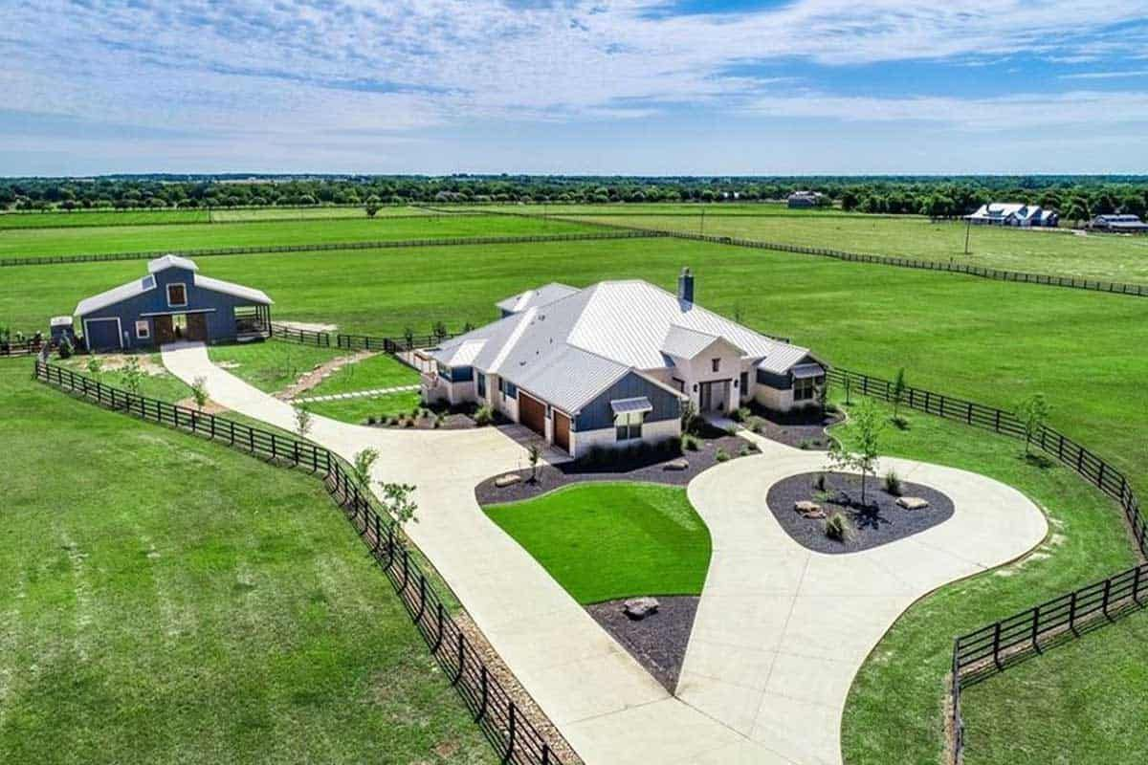
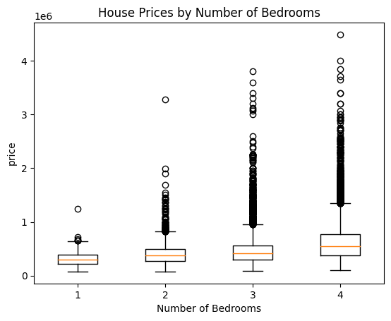
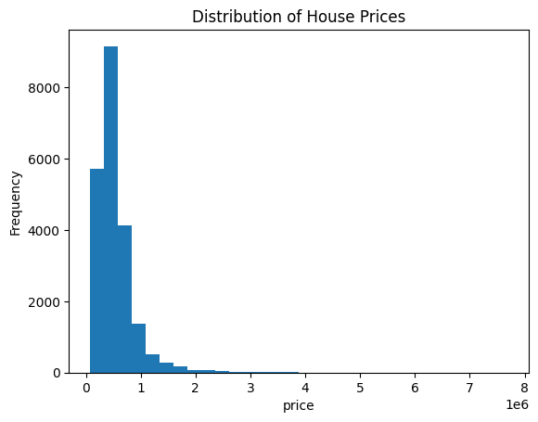
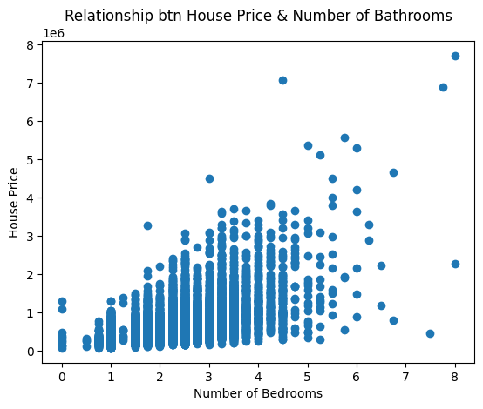
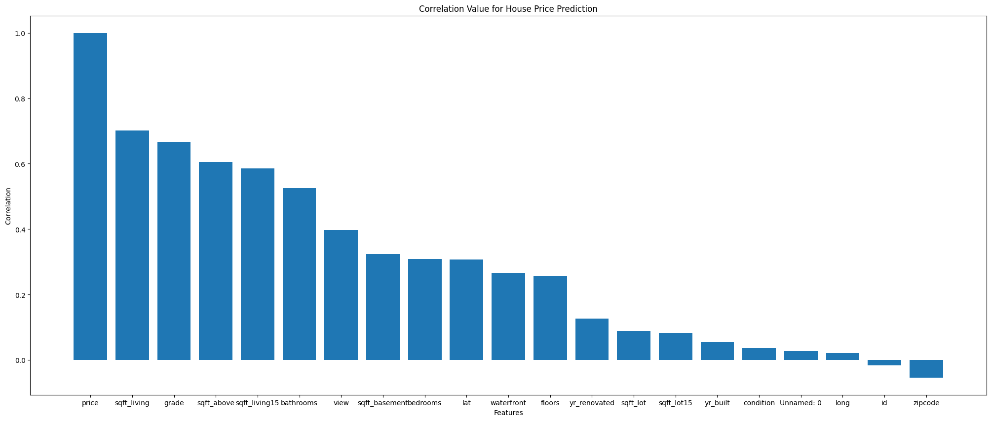
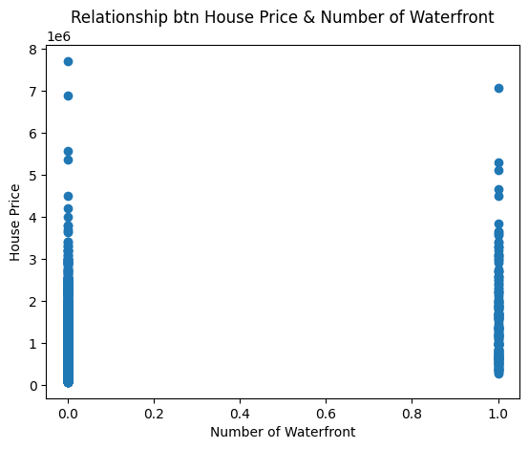
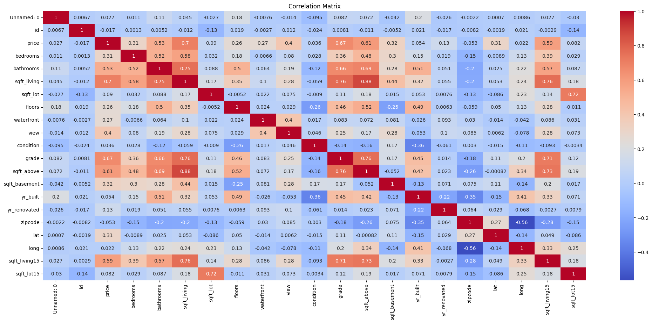
EXAMPLES OF VISUALIZATION

Slide 5

Statistical analysis
I calculated the mean, standard deviation, and mode of house prices using Numpy's mean, std, and mode functions. l also calculated the 25th, 50th, and 75th percentiles of house prices using Numpy's percentile function.
Through data distribution and normal data distribution l then plotted it using Matplotlib's hist and norm functions. The resulting plot shows both distributions, with the normal distribution fit to the data. The plot is titled "Data Distribution".

Slide 6

Findings
Mean: 540088.1417665294
Standard deviation: 367127.19648269983
Mode: 350000.0
25th percentile: 321950.0
50th percentile: 450000.0
75th percentile: 645000.0

Slide 7

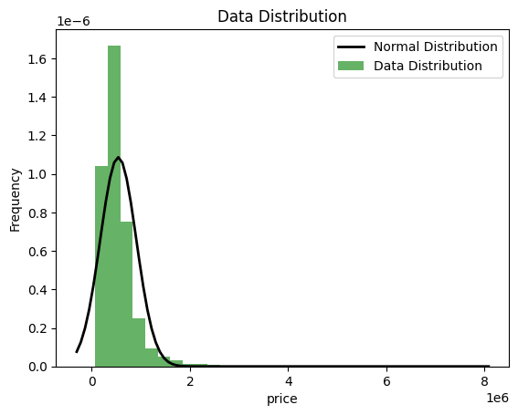
Findings(cont)

Slide 8

Machine learning techniques
i used various machine learning models such as linear regression and decision tree to make predictions.
l used metrics such as mean squared error, R-squared and mean absolute errot to evaluate the performance of our models.
l presented the results of our models using scatter

Slide 9

Finding
Linear Regression Model R^2 score: 0.5069197973159074
Decision Tree Model R^2 score: 0.8188990382217128
Linear Regression Evaluation Metrics:
Mean Squared Error: 42763452212.7866
Mean Absolute Error: 123716.19188553511
R-squared: 0.6885217836662834
Decision Tree Regression Evaluation Metrics:
Mean Squared Error: 34261362813.972702
Mean Absolute Error: 99776.0778840222
R-squared: 0.7504488616738094

Slide 10

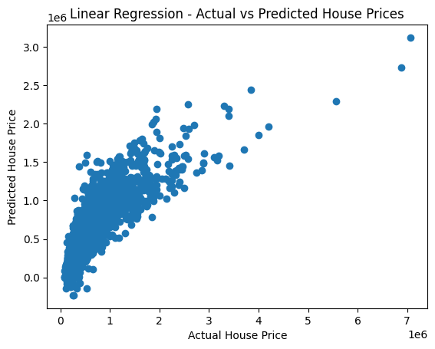

Slide 11
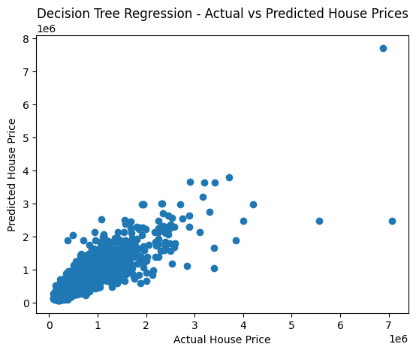

Slide 12
Explanation
To evaluate the performance of the house price prediction model, we can use metrics such as mean squared error (MSE), mean absolute error (MAE), and R-squared (R2).
The mean squared error (MSE) measures the average squared difference between the predicted and actual values. The lower the MSE value, the better the model's performance.
The mean absolute error (MAE) measures the average absolute difference between the predicted and actual values. Like the MSE, the lower the MAE value, the better the model's performance.
The R-squared (R2) value measures the proportion of variance in the target variable that is explained by the predictor variables. The higher the R2 value, the better the model's performance.

Slide 13

Sample of the actual and predicted value
Actual Predicted
17384 297000 3.943785e+05
722 1578000 1.502469e+06
2680 562100 5.185841e+05
18754 631500 5.781470e+05
14554 780000 9.984026e+05
... ... ...
18588 1100000 5.205834e+05
6784 700000 5.473781e+05
14510 380000 3.394741e+05
18917 268000 2.294610e+05
11750 206000 1.673608e+05

Slide 14
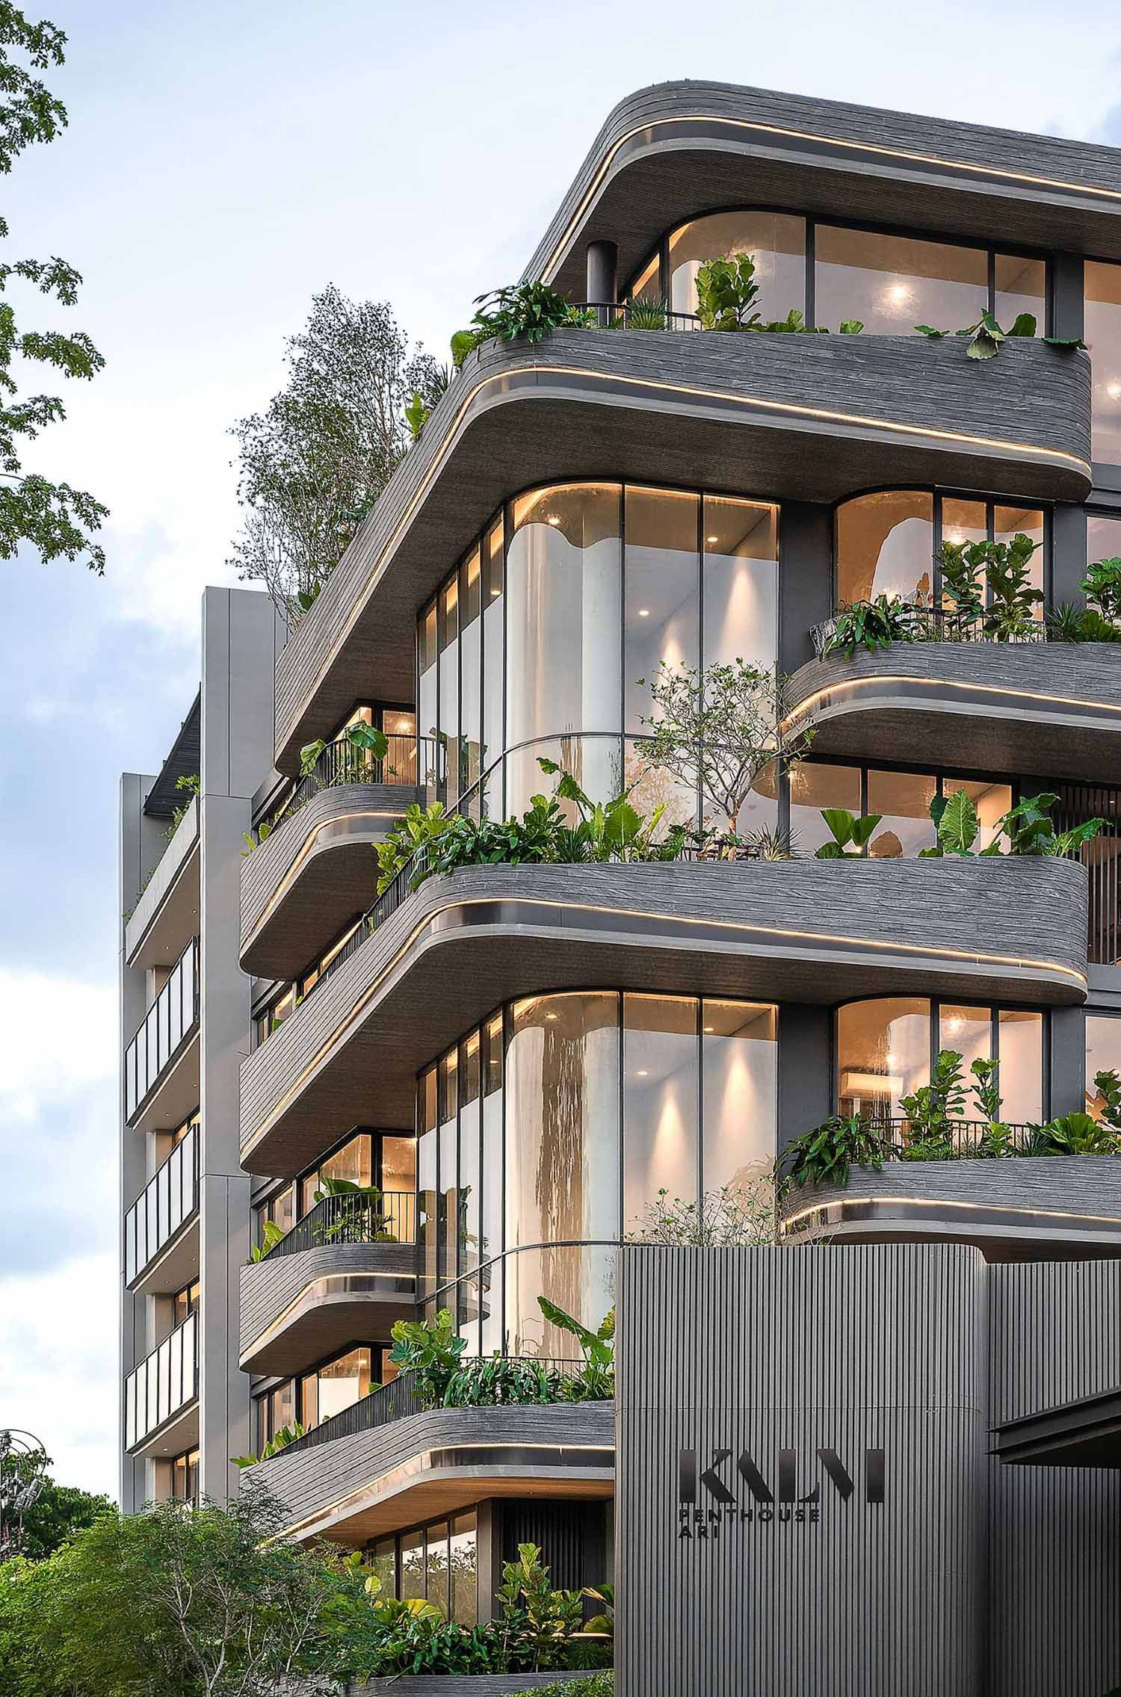
REFERENCES
https://www.w3schools.com/python/
https://www.tutorialspoint.com/python/index.html

